Slide 1

Capstone Project:1 EDA Hotel Booking Amitha Sridhar

Slide 2
Introduction
Hotel rooms are your second home on your journey.
The global hotel industry is a $525bn industry, made up of around 18 million rooms.
But this is a very massive competitive market and to be the front runners the hotels will have to keep up with the customer demands and needs. The study of the trend will help these players to upgrade themselves.
In this project we will be using our knowledge of python to study the compressed data of hotel booking. We will be studying about 2 hotel types i.e the city hotel and resort hotel. We will be studying factors like lead time, wait time, deposit, meal types etc to understand what's more in demand.
We will be deducing conclusions such as:-
> Optimal stay
> Distribution channels who can get maximum revenue
> Market segment which gets most revenue
> Customer type who can get in most business
> Does meal types, deposit and car parking be a factor
> Finally the most successful country who get the most revenue

Slide 3
Workflow
Problem Statement and collection raw data
Data cleaning and Data Manipulation
Exploratory Data Analysis
Data visualization
Analyzing the result

Slide 4
Attributes in the study
This data has 119390 rows and 32 columns. Here are the columns
Previous_cancellations
Previous_bookings_not_canceled
Reserved_room_type
Assigned_room_type
Booking_changes
Deposit_type
Agent
Lead_time
Days_in_waiting_list
Customer_type
Adr
Required_car_parking_spaces
Booking changes
Reservation_status
reservation_status_date
Previous_cancellations
Previous_bookings_not_canceled
Reserved_room_type
Assigned_room_type
Booking_changes
Deposit_type
Agent
Lead_time
Days_in_waiting_list
Customer_type
Adr
Required_car_parking_spaces
Booking changes
Reservation_status
reservation_status_date

Slide 5
Data Wrangling
Dropping columns with max null values
Clean Data
Data Manipulation
Replacing Null Values

Slide 6
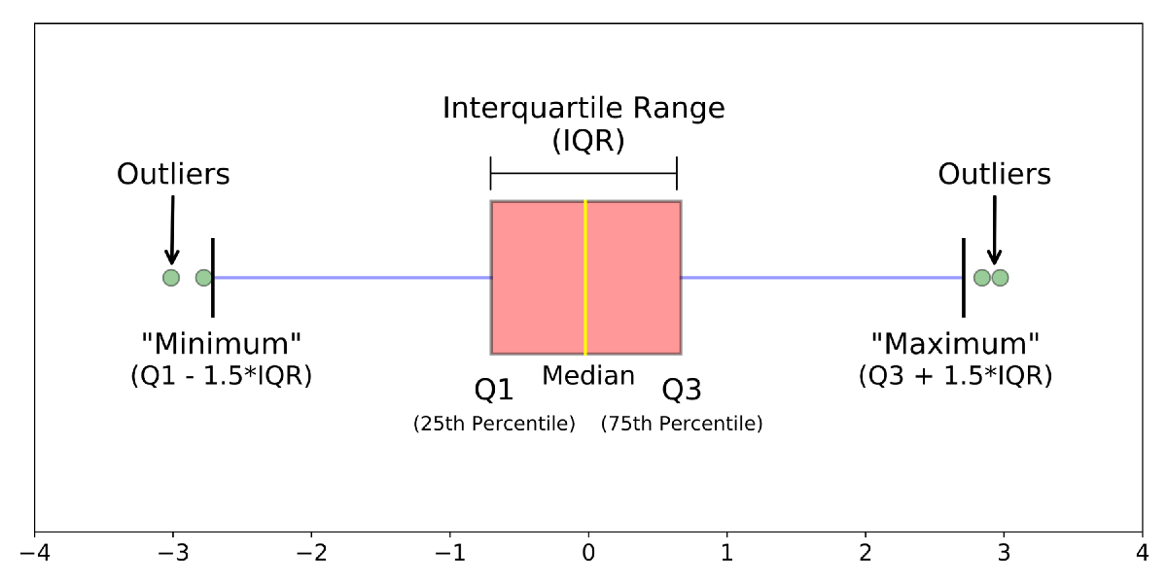
Handling outliers

Slide 7
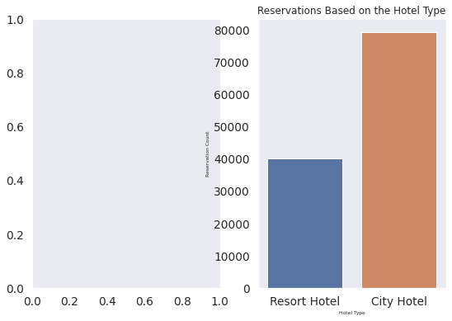
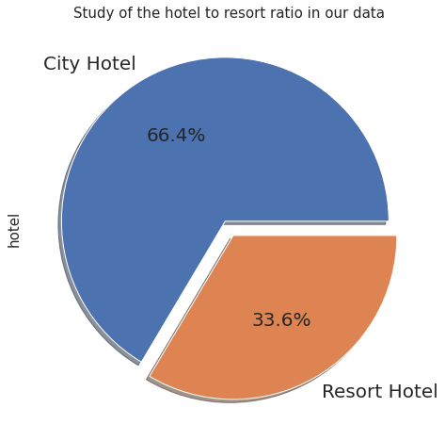
Data visualization

Slide 8
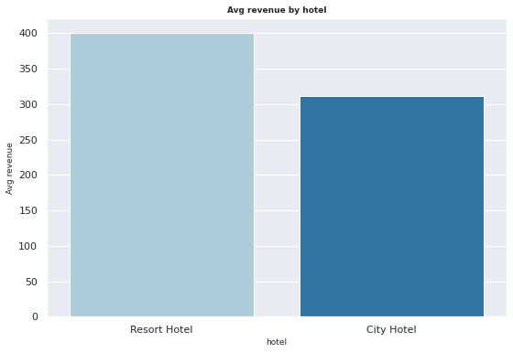
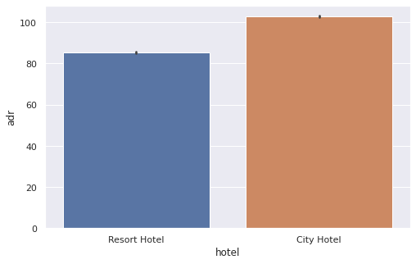
ADR and Revenue study

Slide 9
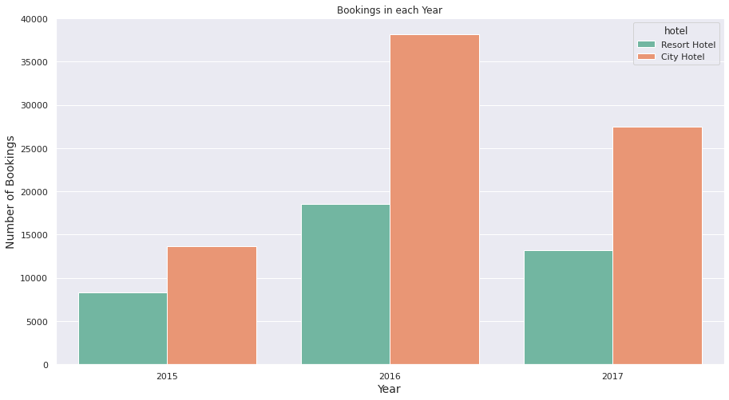

Slide 10
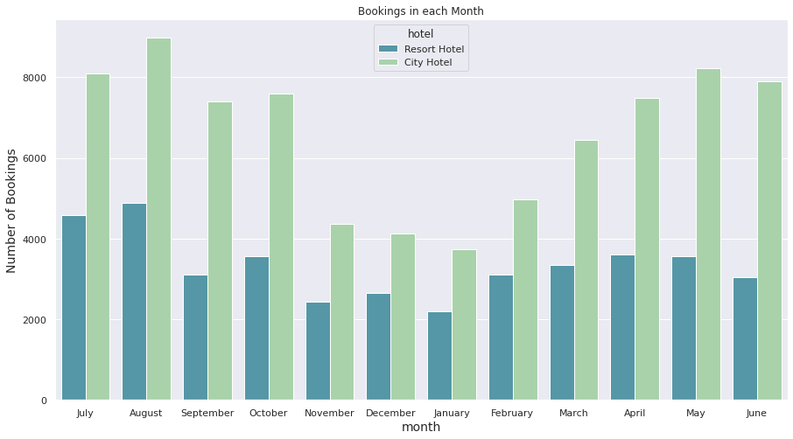

Slide 11
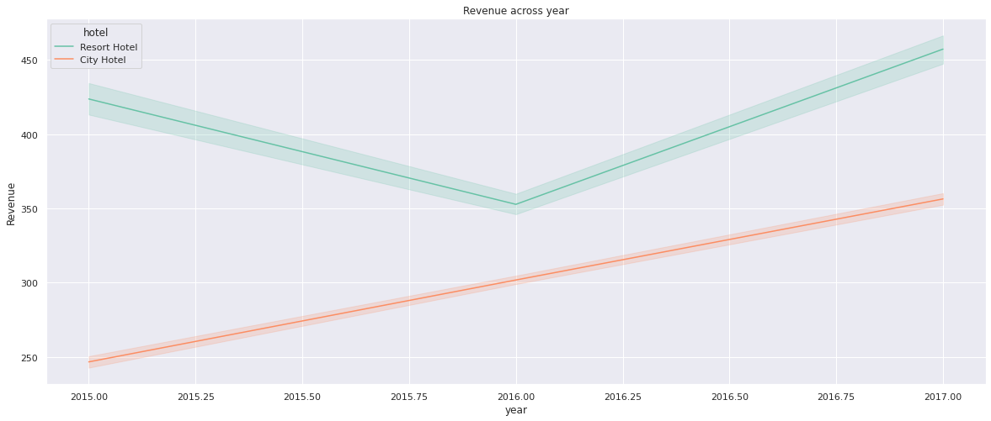
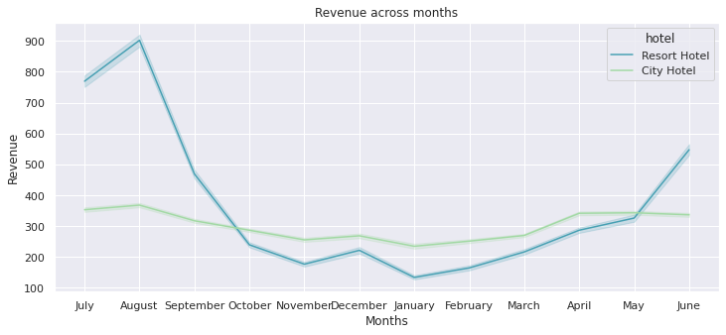

Slide 12
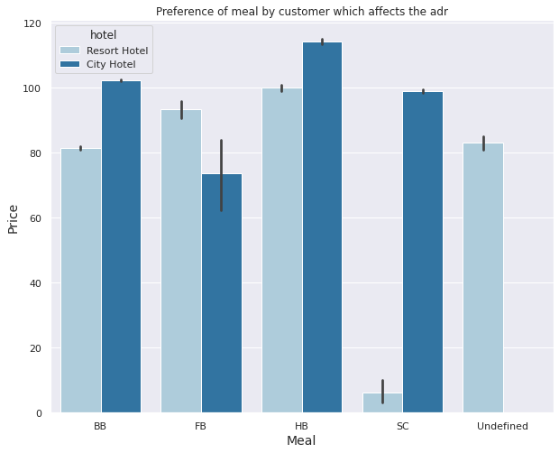
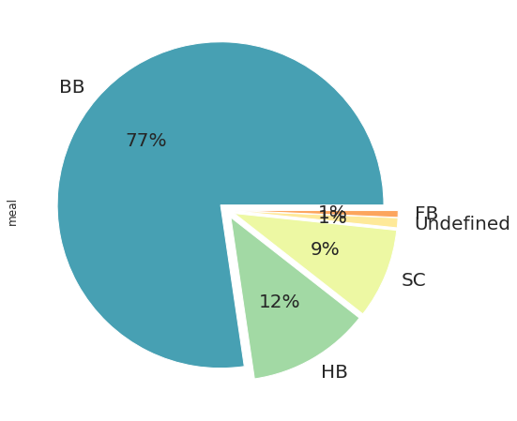
Meal studies

Slide 13
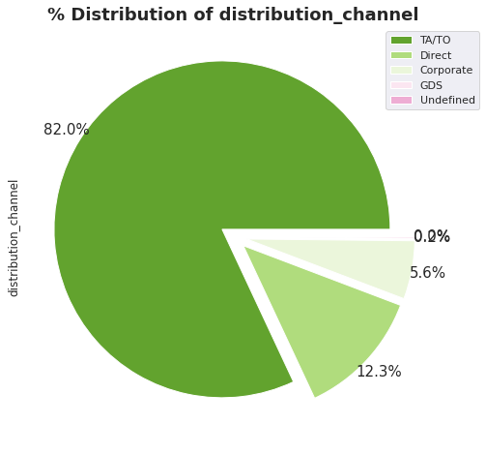
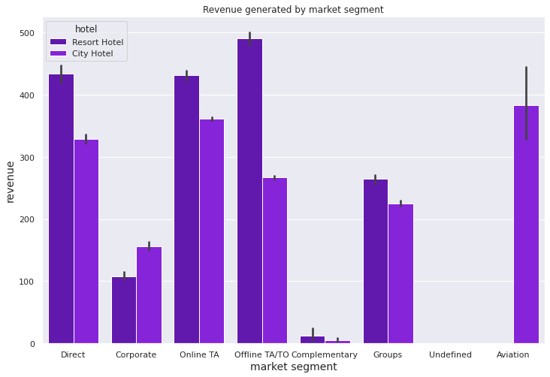
Market segment and distribution channel

Slide 14
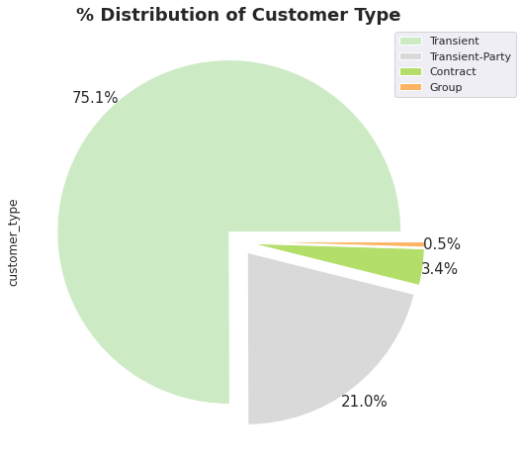
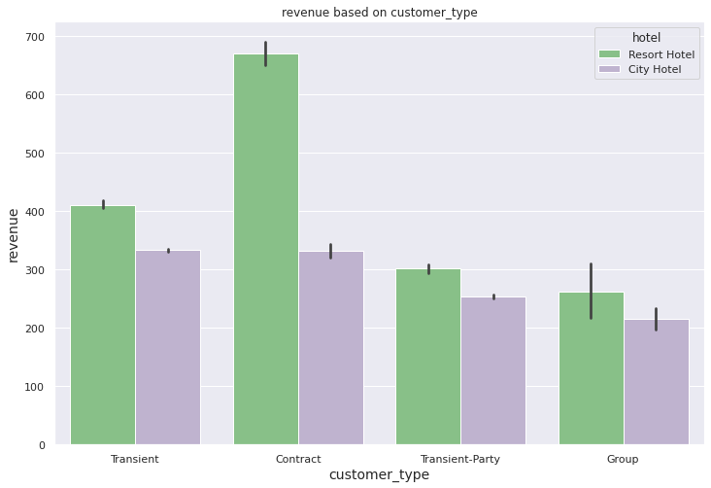
Customer Type

Slide 15
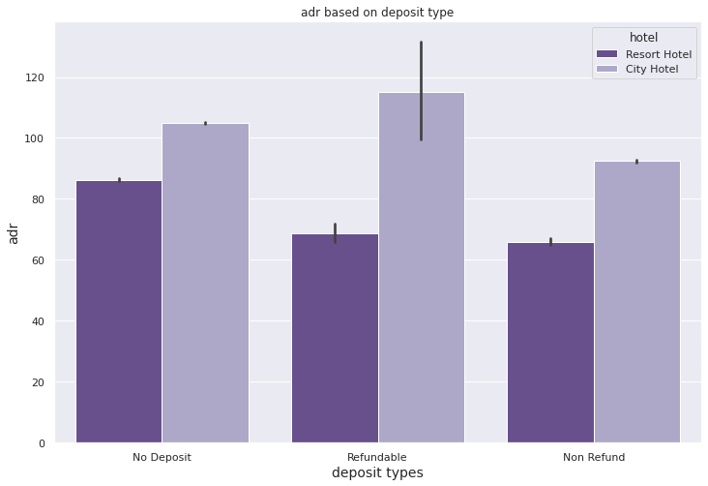
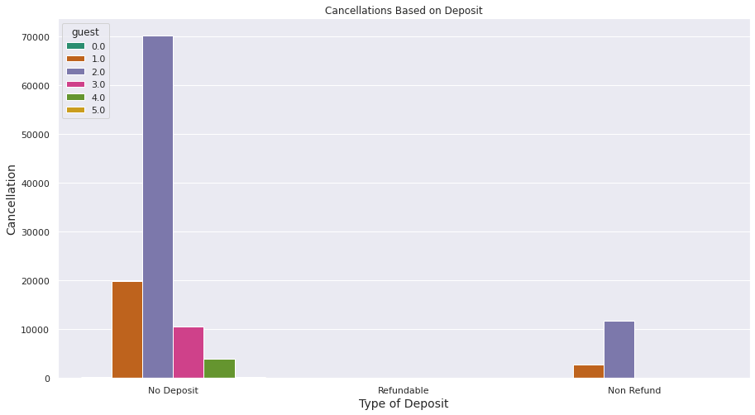
Deposit study

Slide 16
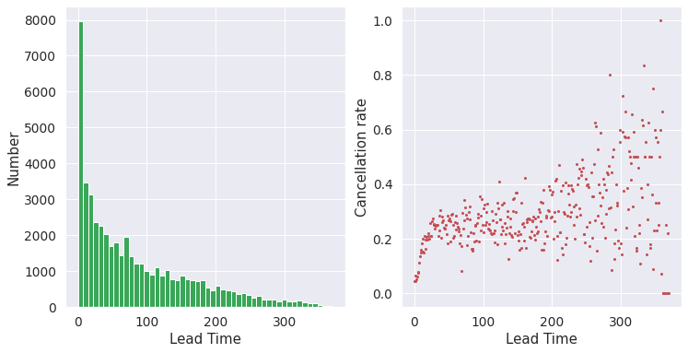
Lead time
City hotel types have more lead time

Slide 17
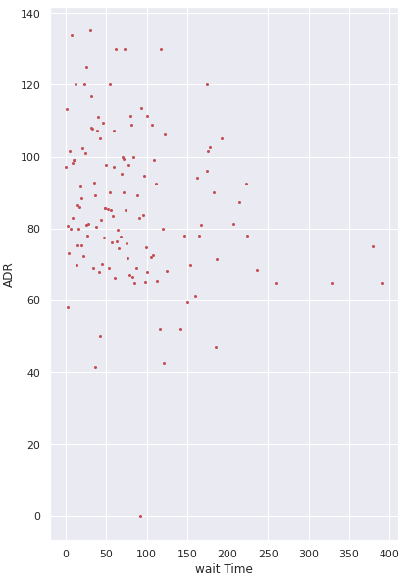
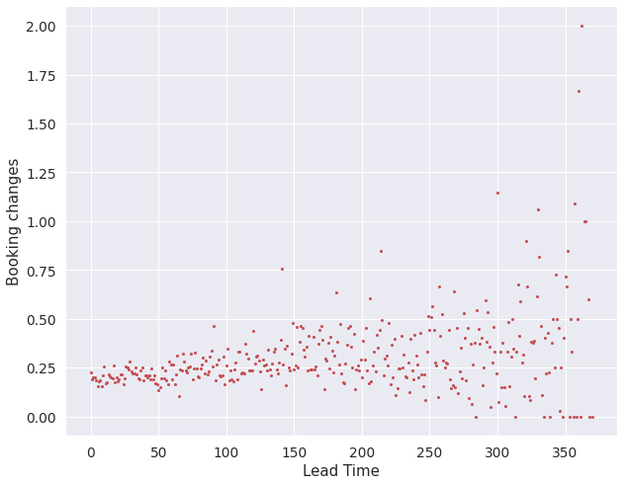
ADR vs Lead Time
Booking changes vs Lead time

Slide 18
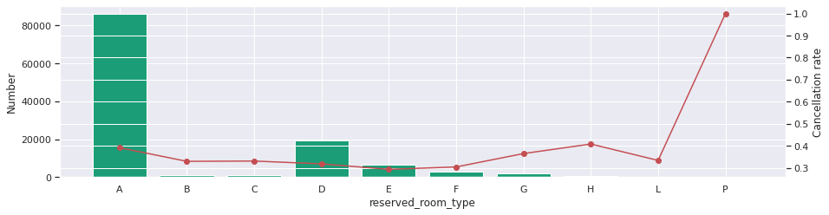
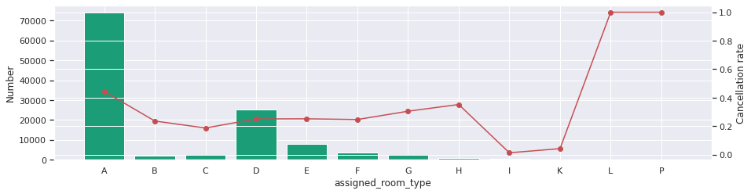
Room Type study

Slide 19
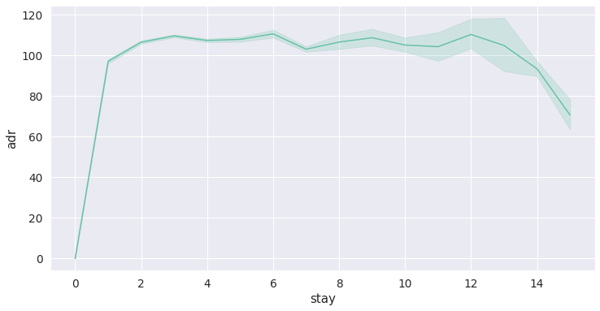
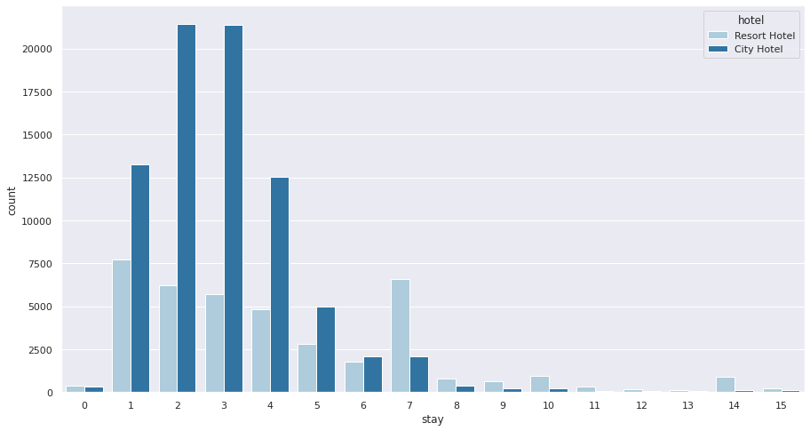
Optimal stay

Slide 20
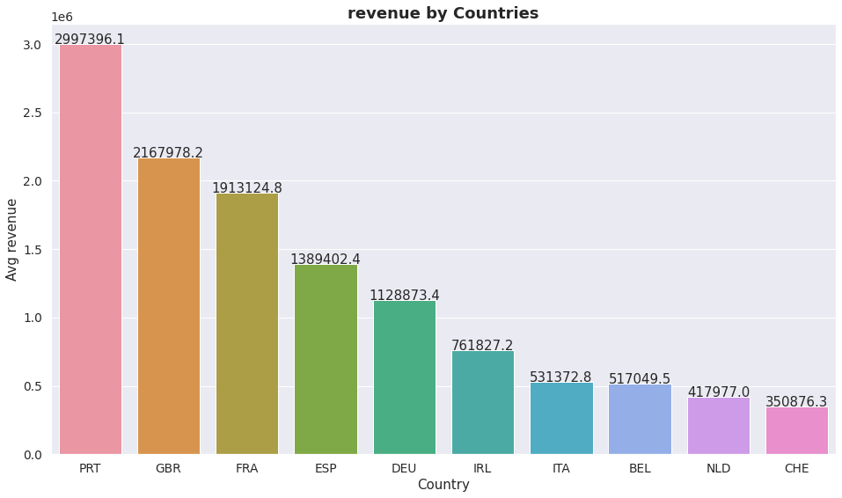

Slide 21



